Slide 1
Tree Answers
Marty Morgan, Cooke County Extension Agent for Agriculture

Slide 2
5 Questions to Ask Before You Plant a Tree in Your Yard
What will the tree’s height be when it reaches maturity?
How wide will the canopy be?
Will it drop a lot of leaves in the fall or stay green all year round?
Does it grow fruit?
What are the trees needs to grow healthy and strong?

Slide 3
CHOOSING THE RIGHT TREE FOR YOUR LANDSCAPE
Is the tree or shrub meant to attract birds?
Does the tree need to provide shade?
Do you need a plant for a privacy screen?
Are you looking for a plant to enhance the appearance of your home?
Do you want a plant that will help identify an entrance or exit?

Slide 4
Considerations for selecting a tree:
Hardiness - the ability of the tree to survive extremes of cold and heat.
Mature height and spread - will it grow large enough to serve the intended purpose, or grow too big and hinder surrounding plants or encroach on your house.
Growth rate - will it grow at a proper rate to fulfill the purpose intended.
Cleanliness - does it drop lots of leaves, berries, nuts, seeds, or other material that will add to regular yard clean-up or possibly harm other plants?
Type of root system - how much space does it require, and what type of soil

Slide 5
Considerations for selecting a tree:
Moisture and fertilizer requirements - how much maintenance work should be expected for the tree.
Space available - how much room does the tree require, both below ground and above.
Maintenance requirements - will it require regular pruning, trimming, spraying, and other care.
Availability - is the desired tree available in your area.
Ornamental effects - how does the tree branch out, what is its texture, the color of the bark, any flowers, fruit and foliage, and whether the tree is evergreen or deciduous.

Slide 6
Determine environmental conditions that may limit your selections
Potential disease and insect problems
Prior use of the planting site
Soil conditions, such as drainage, and pH levels
Local wind conditions
Location of above and below ground utilities which must be avoided and will limit plant choice and location
Position of plants in relation to buildings, roads, walkways, and security lighting

Slide 7
Is there enough space available for the new tree
Availability of space at the site and the eventual size of trees after they reach maturity are critical considerations.
Planting locations may be limited by community ordinances that restrict planting near power lines, parking zones, street lights, sewer pipes, traffic control signs and signals, sidewalks, and property lines.

Slide 8
Determine the appropriate size
The tree you plant should be proportional to the size of your lot. If you plant huge shade trees on a small landscape, they will appear overwhelming and will not allow adequate light to enter into the house or garden.
The general rule of thumb is that, if a tree is likely to grow to 100 feet in height, it should be at least 30 feet from the home’s foundation, patio or pathways.

Slide 9
What kind of Trees should I choose?
Deciduous trees are those that drop their leaves at the end of the growing season and produce new leaves in the spring. They are generally angiosperms, or flowering plants. Flowering trees are also known as broadleaved trees.
Coniferous(or Evergreen) trees have needles or scales that do not fall off.

Slide 10
Shade Trees that do well in North Texas

Slide 11
Mexican White Oak-The Dream Tree

Slide 12
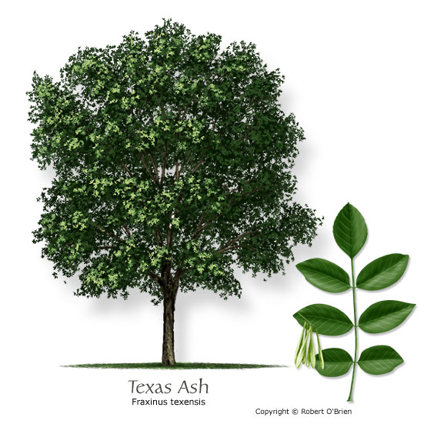
Texas Ash
Common Name: | Texas Ash

Slide 13
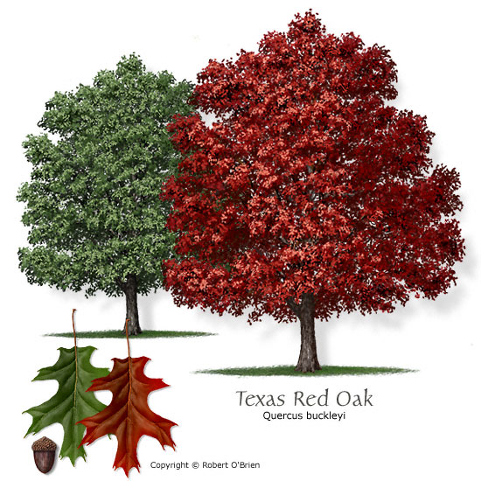
Texas Red Oak
Common Name: | Texas Red Oak (Spanish Oak)
Latin Name: | Quercus buckleyi
Tree Size: | Medium
Leaf Type: | Deciduous
Growth Rate: | Moderate
Water Needs: | Dry
Tolerances: | Drought, alkaline soils (pH > 7.5)
Attributes: | Texas native, reliable fall color, seeds or fruit eaten by wildlife
Features: | Bark has interesting texture; Fall color is brilliant red.
Comments: | Several "red oaks" available; Also referred to as Q. texana.
Problems: | Oak wilt is a serious disease problem for this species.
Firewise: | Yes

Slide 14
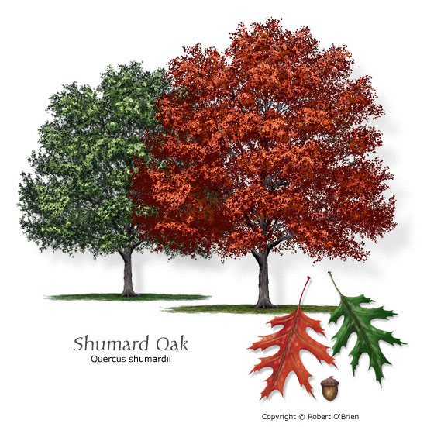
Shumard Oak
Common Name: | Shumard Oak
Latin Name: | Quercus shumardii
Tree Size: | Large
Leaf Type: | Deciduous
Growth Rate: | Rapid
Water Needs: | Moderate
Tolerances: | Drought, poorly drained sites, alkaline soils (pH > 7.5)
Attributes: | Texas native, reliable fall color, seeds or fruit eaten by wildlife
Features: | Young trees have "candelabra" shape; fall color is orange to deep red.
Comments: | Widely available; prefe

Slide 15
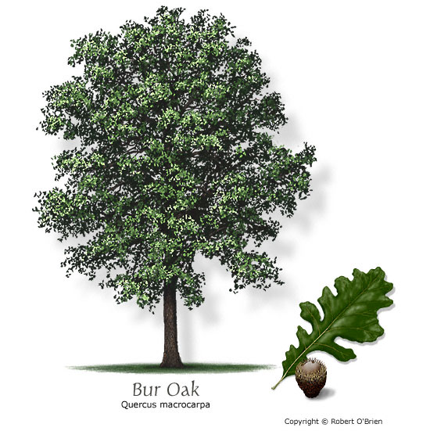
Bur Oak (Mossycup Oak)
Common Name: | Bur Oak (Mossycup Oak)
Latin Name: | Quercus macrocarpa
Tree Size: | Large
Leaf Type: | Deciduous
Growth Rate: | Slow
Water Needs: | Moderate

Slide 16
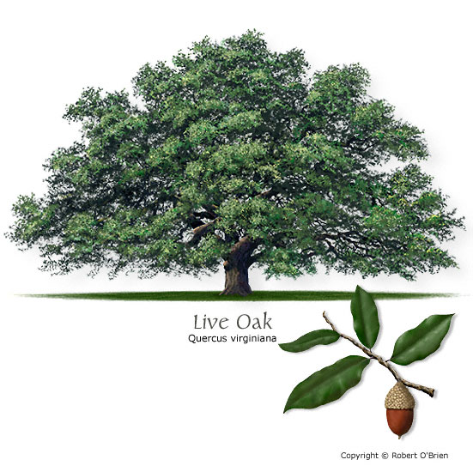
Live Oak (Encino)
Common Name: | Live Oak (Encino)

Slide 17
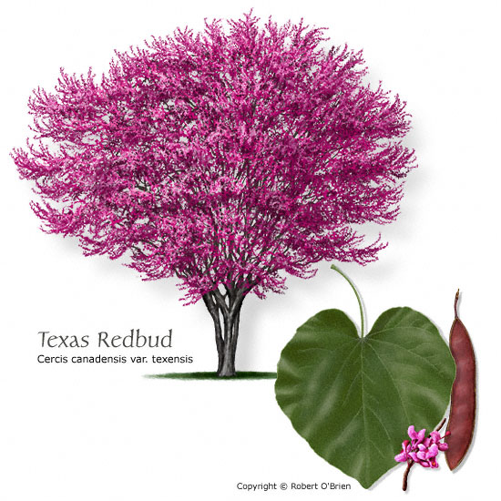
Texas Redbud
Common Name: | Texas Redbud
Latin Name: | Cercis canadensis var. texensis
Tree Size: | Small
Leaf Type: | Deciduous
Growth Rate: | Rapid
Water Needs: | Moderate
Tolerances: | Drought, alkaline soils (pH > 7.5)
Attributes: | Texas native, showy or fragrant flower, attractive seeds or fruit
Features: | Glossy green leaves, purple flowers, and brown seed pods provide year round interest.
Comments: | Good choice for Central and West Texas.
Problems: | Short-lived, often due to stem cankers.

Slide 18
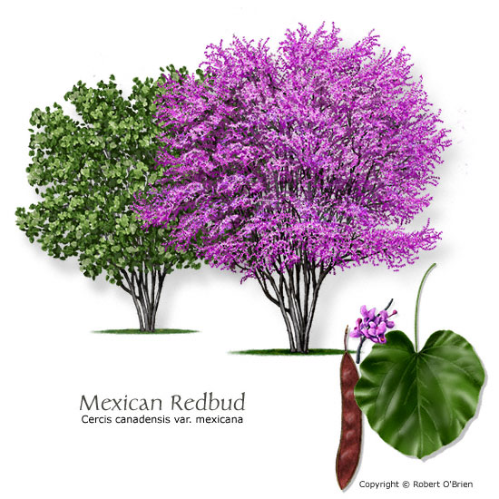
Mexican Redbud
Common Name: | Mexican Redbud
Latin Name: | Cercis canadensis var. mexicana
Tree Size: | Small
Leaf Type: | Deciduous
Growth Rate: | Slow
Water Needs: | Dry
Tolerances: | Drought, alkaline soils (pH > 7.5)
Attributes: | Texas native, showy or fragrant flower, attractive seeds or fruit
Features: | Small, glossy, wavy-edged leaves, pink to purple flowers, and brown seed pods.
Comments: | Southwestern variety suited for drier sites.

Slide 19
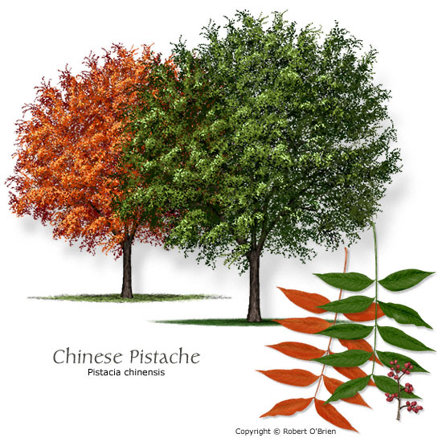
Common Name: | Chinese Pistache

Slide 20
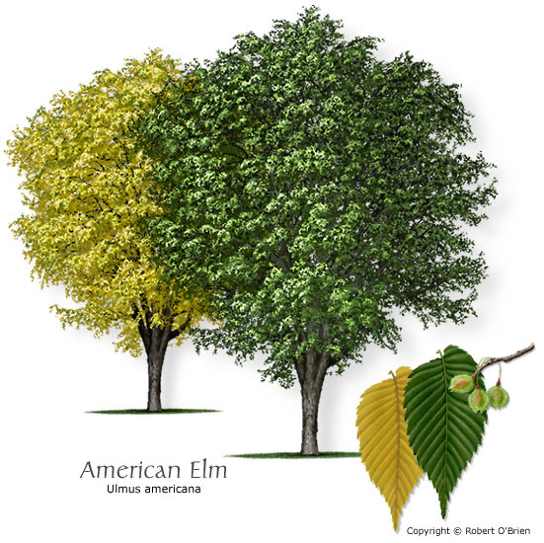
American Elm (White Elm)
Common Name: | American Elm (Whit

Slide 21
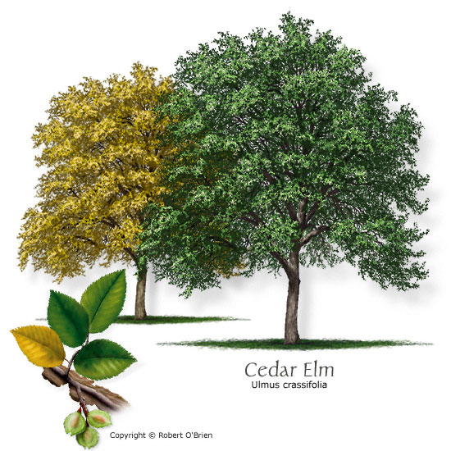
Cedar Elm
Common Name: | Cedar Elm

Slide 22
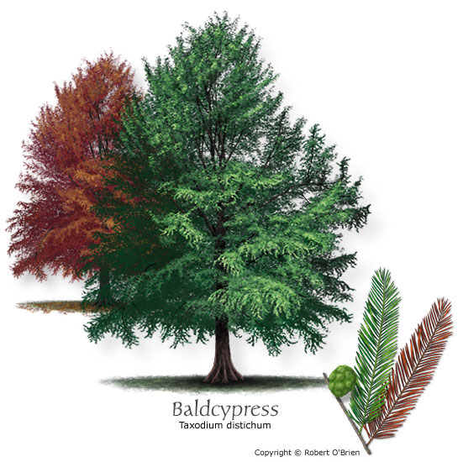
Baldcypress
Common Name: | Baldcypress

Slide 23
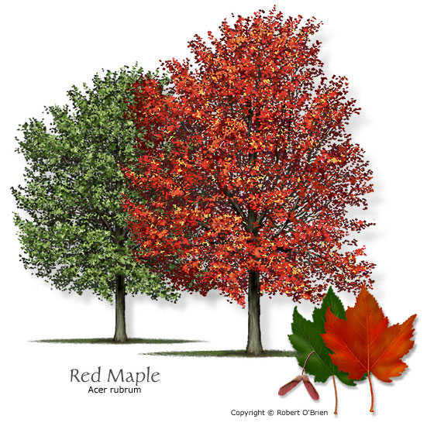
Common Name: | Red Maple

Slide 24
Planting or placing a tree
prepare a hole two to three times as wide as the root ball of your tree. Handle the root ball carefully to keep it intact while you place it in the hole.
Once it's in, turn it so the best side of the tree is facing the direction you want. With burlapped root balls, cut the twine and remove the burlap (or at least push it to the bottom of the hole).

Slide 25
Backfill the Hole
Backfill around the root ball, lightly packing the soil as you go. Frequently check the trunk to ensure that it's straight. Use leftover soil as a berm to create a watering well.
A large planting hole and loose soil is vital so that the new roots can easily grow and spread

Slide 26
Stake the Tree
Drive the stake through the root ball into the ground underneath. The stake should be tied loosely to the trunk; do not lash it tightly.
Large trees may need two or three stakes placed several feet from the trunk.
The size of the tree determines where to put the stakes in order to secure the tree from wind or storm damage.

Slide 27
Watering the Tree
Right after planting, water the tree in by filling the bermed basin with water. This will settle the existing soil around the root ball.
First week after planting, lightly water the tree every day (about one pint to one quart of water each day).
Second week, water every other day with about one to two quarts of water.
Week three, water every third day with two to three quarts of water.
Week four and beyond, water once a week if needed.
The goal is to wean the tree slowly off of supplemental irrigation, and produce a root system large enough for the tree to thrive on natural rainfall.

Slide 28
Growth stage 1 – Planting to newly planted

Slide 29
Amount of common fertilizers to apply application rate of 0.1 lb N/100 sq. ft.
Product analysis¹ | Chemical name | lbs/100 sq. ft.
45-0-0 | Urea | 0.2
38-0-0 | Urea form | 0.3
33-0-0 | Ammonium Nitrate | 0.3
21-0-0 | Ammonium Sulfate | 0.5
18-6-12 | Osmocote | 0.5
14-14-14 | Osmocote | 0.7
12-12-12 | – – – | 0.8
10-10-10 | – – – | 1.0
¹Other fertilizers are available. To calculate the amount to use for an application rate of 0.1 lb N / 100 sq. ft. use the formula [0.1 / (Percent of N in the fertilizer / 100)].

Slide 30
Growth stage 2 – Rapid growth on young trees
On young landscape trees where rapid growth is desirable, use the high maintenance rate given in Table 3.
During the rapid growth phase, the N rate should be 0.2 to 0.4 lb N/100 sq. ft. per year. A low maintenance level should be used in situations that restrict growth
For trees in lawn areas, do not exceed 0.1 lb N/100 sq. ft. per application unless a slow release or natural fertilizer is used. Higher rates will burn the grass.

Slide 31
Growth stage 2 – Rapid growth on young trees and shrubs
 | Maintenance level
Soil organic matter level³ | Low¹ | High²
 | Amount of nitrogen (N) to apply (lb. N/100 sq. ft.)
Low | 0.10 | 0.20
Medium to high | 0.07 | 0.05
Organic soils | 0.10 | 0.15
¹Use the low maintenance level: For newly planted landscape plants To maintain health of mature trees and shrubs where rapid growth is not desirable For young trees and shrubs under restricted growing conditions
²Use the high maintenance level on young trees and young landscape plants when rapid growth is desired.
³Low organic matter = less than 3.1%, medium to high = 3.1 to 19%, organic soil = greater than 19% organic matter. Organic matter may be determined by a soil test.

Slide 32
Growth stage 3 – Maintaining maturing trees and shrubs
As trees and shrubs mature and growth rate naturally slows down, the need for N drops.
The low maintenance level in Table 3 should be used for established trees and shrubs.
The purpose of this low maintenance level is to maintain landscape plants in a healthy condition without excessive vegetative growth.

Slide 33
Growth stage 3 – Maintaining maturing trees and shrubs
 | Maintenance level
Soil organic matter level³ | Low¹ | High²
 | Amount of nitrogen (N) to apply (lb. N/100 sq. ft.)
Low | 0.10 | 0.20
Medium to high | 0.07 | 0.05
Organic soils | 0.10 | 0.15
¹Use the low maintenance level: For newly planted landscape plants To maintain health of mature trees and shrubs where rapid growth is not desirable For young trees and shrubs under restricted growing conditions
²Use the high maintenance level on young trees and young landscape plants when rapid growth is desired.
³Low organic matter = less than 3.1%, medium to high = 3.1 to 19%, organic soil = greater than 19% organic matter. Organic matter may be determined by a soil test.

Slide 34
When to fertilize
Most trees experience a single flush of growth during spring followed by slower growth throughout the summer and fall. Because of this single flush of growth, it is desirable to have nutrients available to the tree as this growth is about to occur.
The most beneficial time to apply fertilizer is from when the ground is workable in the spring until just before trees start growing in early May.
On sandy soils, applications should be split, half in early spring and half in mid- to late May.

Slide 35
How to Apply Fertilizer
Plants respond best to surface applications of nitrogen fertilizer which are broadcast over the area where the roots of the tree lie, a radius of about 12.5 feet from the center of an established tree (encompassing about 500 square feet).
Dry or granular fertilizers can be applied by hand or with the use of a mechanical spreader.

Slide 36
Water Fertilizer in
Trees should always be watered around the area of fertilizer application soon after fertilizer has been applied. This helps to ensure that the fertilizer will move down to the trees' root system before it can be taken up by weeds or grass.
A good rain (1-2") will also be sufficient to move fertilizer to the trees root zone.

Slide 37
Fertilizer Balance
Remember that plant nutrition is a balancing act and that too much fertilizer, as well as too little, can negatively affect the growth and well being of your trees and lawn.
The correct amount will keep trees healthy and enhance landscape beauty.

Slide 38
What causes Trees to get sick or die?
ADVERSE ENVIRONMENT--stress-droughts, floods, temperature changes all weaken their immune system and ability to fight off pathogens
HARMFUL INSECTS AND DISEASE
OVER WATERING & Fertilizer
Chemical exposure -from spraying to close, drift, using herbicides in your yard
Mechanical Harm -damaged from machinery etc..
OLD AGE

Slide 39
Oak Decline
Trees affected by the fungus first show signs of thinning out and twig dieback in their upper canopy.
Dieback will generally increase each year. As dieback reaches the larger limbs, which comprise the main canopy, sucker growth becomes evident on the main scaffold limbs.
As the disease continues to progress, only the main scaffold limbs remain alive, however, they will eventually die. This may take from five to ten years on live oaks, but less on other oaks after the first visual symptoms are observed.

Slide 41
Post Oaks in various stages of decline

Slide 42
Root Rots
Texas Root Rot, Crown Rot, Cotton Root Rot
Armillaria Root Rot, Phytophthora Root Rot
symptoms of root rot include the dulling of normal leaf color and the loss of a tree's growing vigor. Often leaves may wilt and turn yellow or brown. Major branches can also die or show excessive signs of wilt
Root rot, if left untreated, can cause rapid tree decline and death. Trees sometimes live for many months in a weakened state, while others will die very quickly.

Slide 43
Three Oaks Ranch

Slide 44
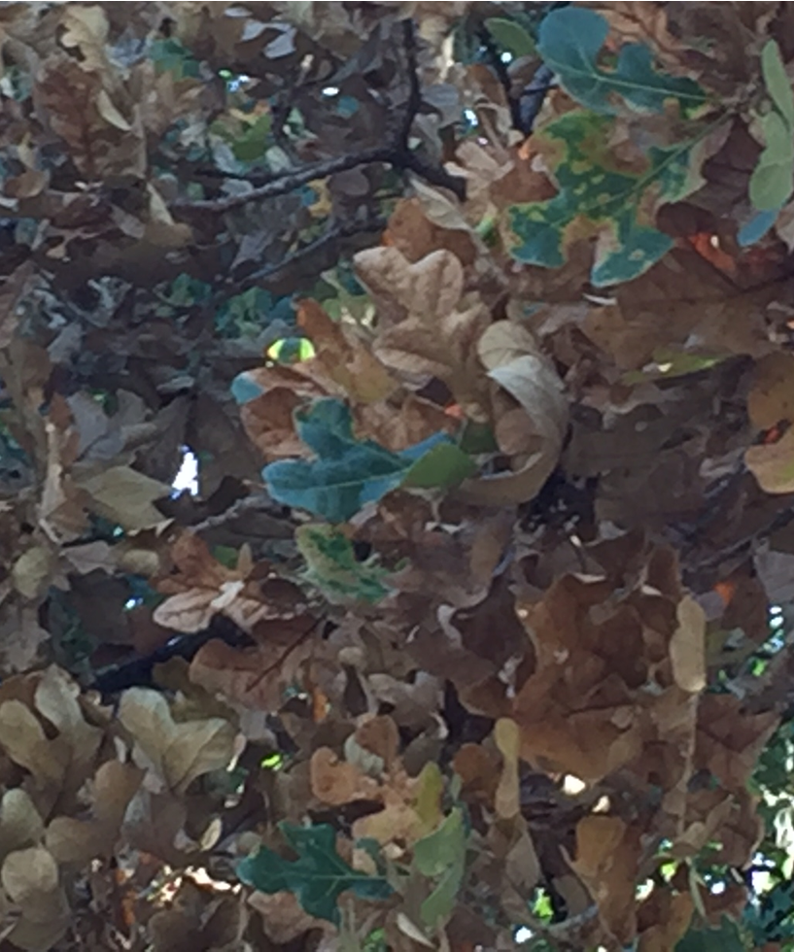
Southeast of Mountain Springs

Slide 45
4 weeks later

Slide 46
Hypoxylon Canker
Hypoxylon canker occurs primarily on trees which are or have been in stressed conditions.
The fungus invades the tree through injured surfaces on its limbs and trunk.
The disease is first evident as a dieback of one or more branches. The foliage of the diseased limbs turns yellow and dries.
This dieback continues from branch to branch until the tree dies.
The fungus infects the inner bark causing the outer bark to slough off..

Slide 47
Trees die from Hypoxylon canker in a random pattern with no movement of the fungus from one tree to another through root grafts
Trees with Hypoxylon canker first appear chlorotic and develop thin foliage. In severe cases leaves die quickly and turn a light brown
In final stage which lasts 1-2 weeks trees go from yellow to brown

Slide 48
Northwest of Callisburg

Slide 49
West of Callisburg

Slide 50
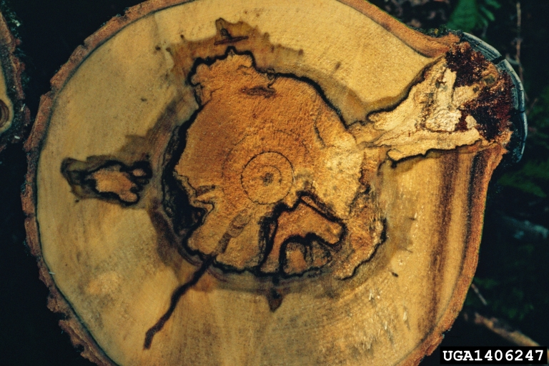
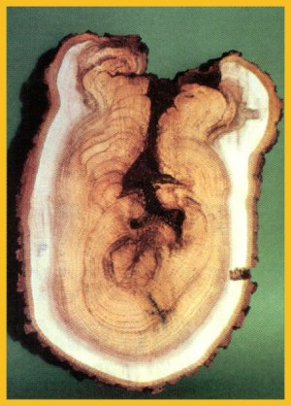
Basically rots the tree

Slide 53
Phloem & Xylem
Plants have two different types of transport tissue. Xylem transports water and solutes from the roots to the leaves
phloem transports food from the leaves to the rest of the plant.
Transpiration is the process by which water evaporates from the leaves, which results in more water being drawn up from the roots.

Slide 54
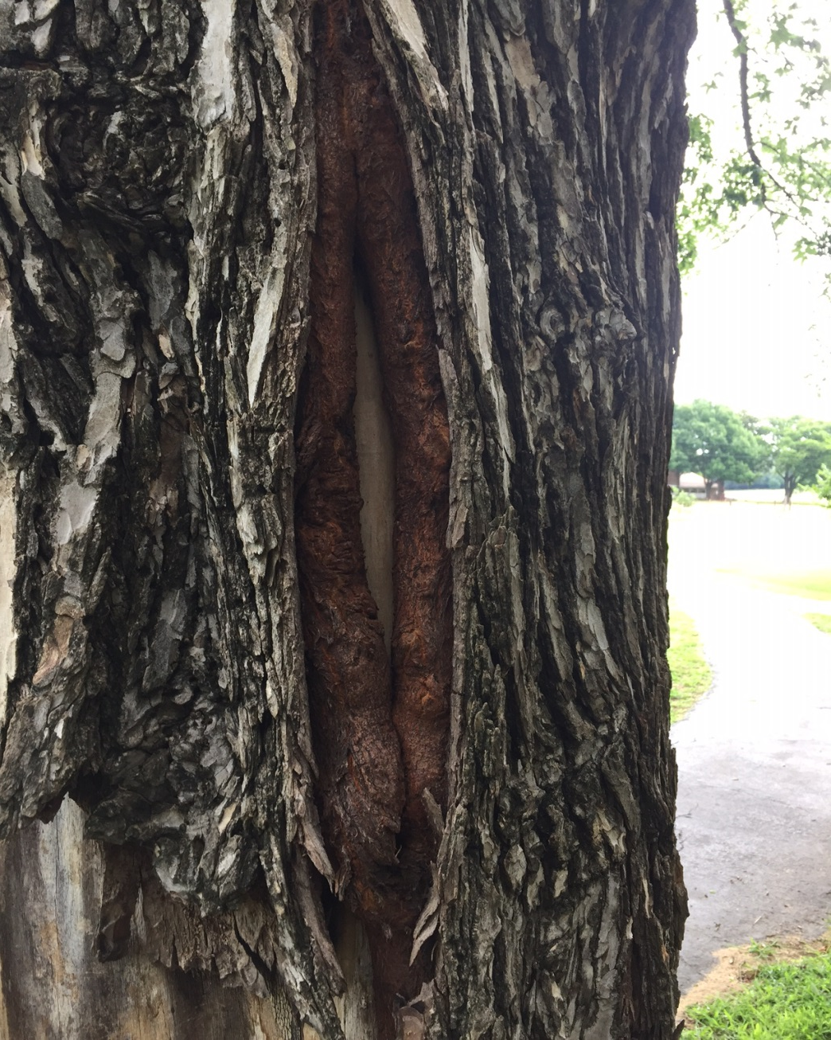
Cambium Tubors

Slide 55
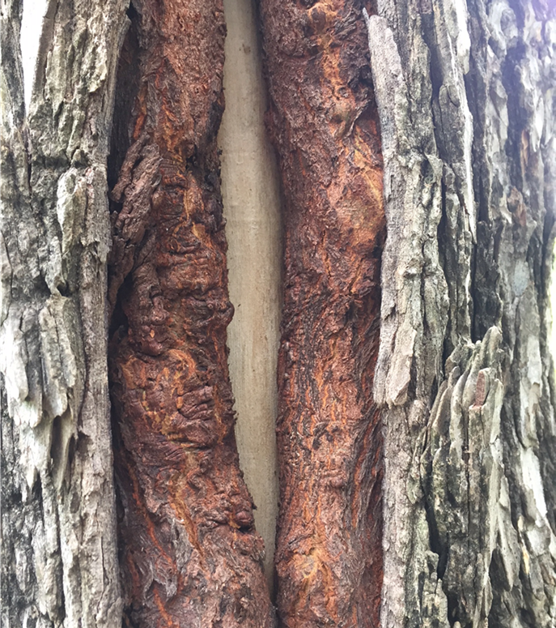
What caused this?

Slide 56
Bacterial Leaf Scorch
a systemic disease caused by the bacterium Xylella fastidiosa, which invades the xylem (water and nutrient conducting tissues) of susceptible trees
Trees may display dieback, branch death, and die prematurely
There is no cure for BLS, but good management practices can delay onset and extend longevity of the tree.

Slide 57
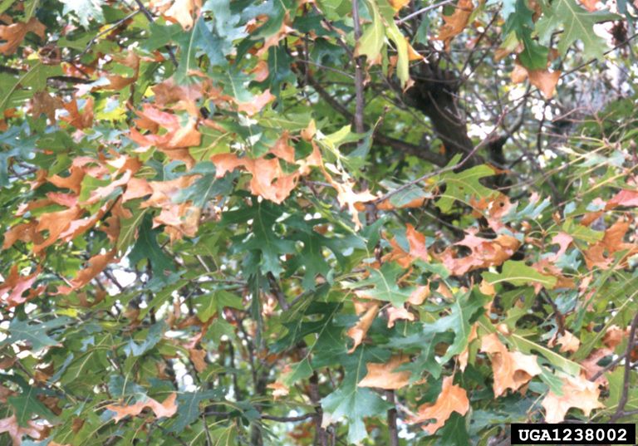
Leaves of Red Oak

Slide 58
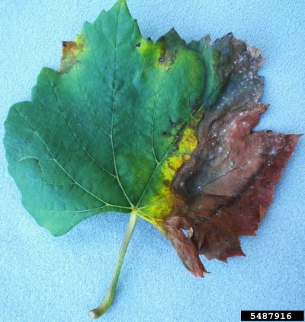
Leaves of American Elm & Maple

Slide 59
Powdery Mildew

Slide 60
Leaf Spot diseases
Leaf spot diseases weaken trees and shrubs by interrupting photosynthesis, the process by which plants create energy that sustains growth and defense systems and influences survival.
most leaf spot diseases affect only a small percentage of the tree's overall leaf area, and are a minor stress on the health of the tree.
Leaf loss during several consecutive growing seasons can result in reduced growth and increased susceptibility to opportunistic pests and pathogens.

Slide 61
Tar Spot

Slide 62
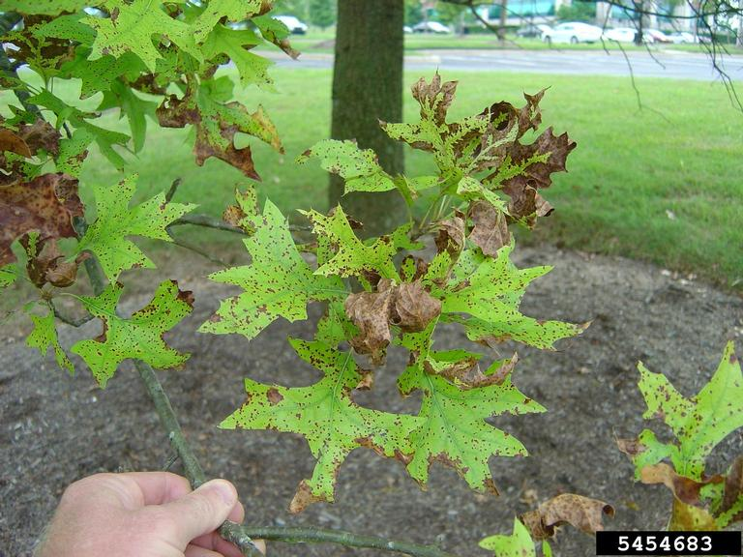
Tubakia Leaf Spot

Slide 63
Anthracnose

Slide 64
Oak Leaf Blisters

Slide 65
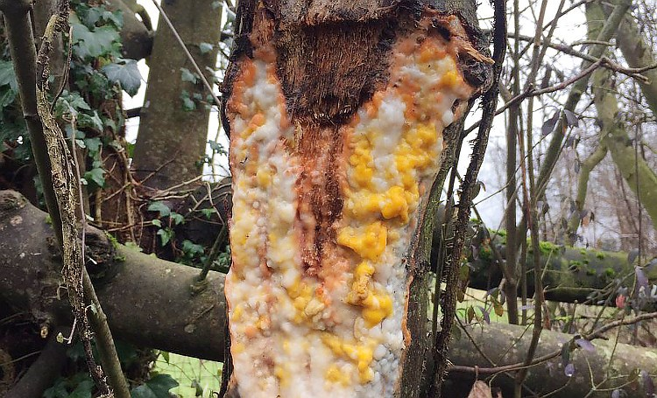
White, Slime or Alcohol Flux

Slide 66
What is Slime Flux?
Slime flux is a bacterial disease of certain trees, primarily elm, cottonwood, poplar, boxelder, ash, aspen, fruitless mulberry and oak. A wound to the bark,caused by pruning, insects, poor branch angles or natural cracks and splits, causes sap to ooze from the wound.

Slide 67
Treatments for these tree diseases
Oak Decline—Agri-Fos & Arbotect is effective in reducing symptoms of oak decline
Hypoxylon Canker—Agri-Fos will help but good care is the best prevention
Root Rots---Agri-Fos works good, Alamo Broad Spectrum Fungicide Injectable into the trunk
Others--Copper based fungicides will work on some tree diseases, read the label

Slide 68
Agri-Fos Systemic Fungicide with Pentra Bark
boosts a trees natural immune response against pathogenic attack and stimulates the tree to tolerate higher levels of environmental stress and pathogen attack
an effective and easy way to control for Oak decline, cankers, root and collar rot, and phytophthora and phythium-related diseases
Is transported throughout the trees vascular system

Slide 69
Helpful Websites
http://texastreeplanting.tamu.edu
https://plantdiseasehandbook.tamu.edu/landscaping/trees/oak/
http://texastreeid.tamu.edu/
https://www.treehelp.com/

