Slide 1
Deciding what to show at County Fair
Freestone County 4-H
Erin Davis

Slide 2
Market Animal Options
Market Lamb
Market Goat
Market Swine
Broilers
Market Rabbits
Market entry fee $25
Entry Cards due by 5pm April 15th

Slide 3
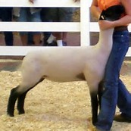
Market Lamb
Can be either a female (ewe) or a
castrated male (wether)
Cost $300 +/-
Minimum weight at fair 70lbs
Should be 6+ months old at county fair (November born would be ideal)
Breed: Suffolk, Hampshire or a cross between the two
Not many breeders close to Freestone County
Must tag in April 10th 7-9am at Fairgrounds (moved to the second Saturday because of Easter weekend)
Entry card can be turned in at tag in or by April 15th at Extension Office
20 make the sale

Slide 4
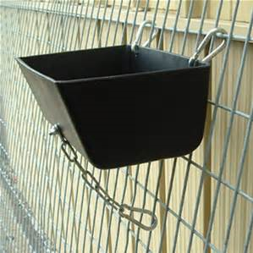
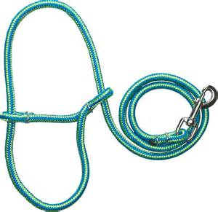
Market lamb supplies needed
Clip on feeder
Water bucket
Halter
Pen size (20 square feet per lamb) should be at least 42 inches tall, so they don’t jump out and have a covering or shade
Exercise area for walking/running
If interested in a lamb collect a Show Lamb guide for more detailed information

Slide 5
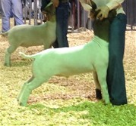
Market Goat
Can either be a female (doe) or a
castrated male (wether)
Cost $400 +/-
Minimum weight at fair 55lbs
Should be 5-6 months old at county fair (December or January born) No older than October Born
Breed: Boer
Many breeders located close to Freestone County
Must tag in April 10th 7-9am at Fairgrounds (moved to the second Saturday because of Easter weekend)
Entry card can be turned in at tag in or by April 15th at Extension Office
30 make the sale

Slide 6
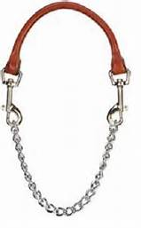
Market goat supplies needed
Clip on feeder
Water bucket
Halter
Show chain
Pen size (15 square feet per goat) should be predator proof and at least 42 inches tall, so they don’t jump out and have a covering or shade
Exercise area for walking/running
If interested in a goat collect a Show goat guide for more detailed information

Slide 7
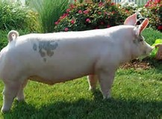
Market Swine
Can either be a female (gilt) or a
castrated male (barrow)
Cost: $250 +/-
Minimum weight 220 lbs, maximum weight 295 lbs
Should be no older than mid October born (November born is ideal)
Breed: Hampshire, Yorkshire, Crossbred
Would require some travel to locate
Must tag in April 10th 7-9am at Fairgrounds (moved to the second Saturday because of Easter weekend)
Entry card can be turned in at tag in or by April 15th at Extension Office
35 make the sale

Slide 8
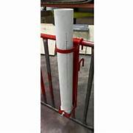
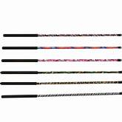
Market swine supplies needed
Clip on feeder
Automatic waterer
Show stick
Pen size (30 sq feet per pig),
should be covered, should have both concrete
and dirt if you can
Larger pen for exercise and showmanship
Practice
If interested in a pig collect a Swine handout for more detailed information

Slide 9
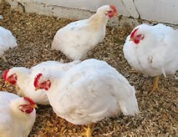
Broilers
Must order from Extension Office by March 30th
Provided by Texas A&M Poultry Department
Cost per pen (25) is around $44
Can order as many pens as you’d like
Can only show 3 at county fair
Must be diligent with feeding and water
and temperature control
Receive chickens May 14th
^{10 make the sale}
If interested in broilers collect more detailed information in the Broiler handout

Slide 10
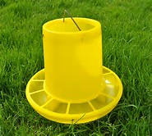
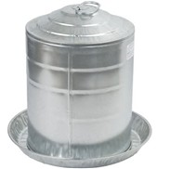
Broiler supplies needed
Temperature controlled environment *Very Important*
Automatic feeder
Automatic waterer
Cage for transportation
Portable scale (optional)-to manage weight gain and feed conversion
No validation necessary, pens based on wing band numbers at pick up
Entry card must be turned in by April 15th at Extension Office

Slide 11
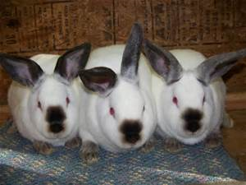
Market Rabbits
List of breeders available
Cost $20 +/- per rabbit
Need to contact breeder by Mid March so they can breed for our Fair
Show best 3 at fair, but need to purchase at least 5
Each rabbit must weigh between 3 to 5.5lbs
Breed: Must be a market breed; Californian, New Zealand
Entry card must be turned in by April 15th at Extension Office
Validation dates will posted at a later date
10 make the sale

Slide 12
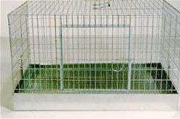
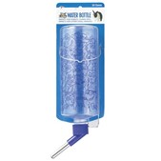
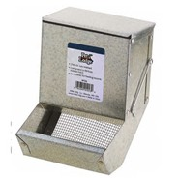
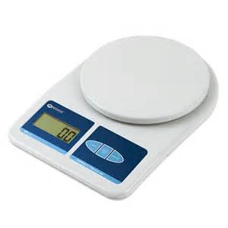
Market Rabbit supplies needed
Cage for all or separate cages for each rabbit
Automatic waterer
Feeder
Fan and/or Air conditioner
Temperature controlled environment *very important*
Portable scale with ounces (to check weight)
If interested in Rabbits collect a Rabbit handout for more detailed information

Slide 13
Breeding Animals
All Breeding sheep, swine and goats must be validated. At the same time as market animals April 10th 7-9am at Fairgrounds (moved to the second Saturday because of Easter weekend)
Any female: sheep, goat or swine can be shown in both the Breeding show and the Market show
Breeding Rabbits must be different than your market rabbit pen, can be bucks or does. Must be validated at validation
No breeding chicken show
No Halter horse show
Heifers: Can be registered or non-registered to show at county fair, Must own by April 1st.

Slide 14
Project Clinics & important dates
Beef Cattle Clinic: To be determined
Swine Clinic: To be determined
Sheep/Goat Clinic: To be determined
Market & breeding sheep, goat, swine tag in April 10th 7-9am at Fairgrounds (moved to the second Saturday because of Easter weekend)
Order Broilers in March 2020
Rabbit Validation will be posted at a later date
ALL County Fair Entry Cards due by 5pm April 15, 2020 in Extension Office.

Slide 15
Fair Information
Can be found at: freestonecountyfairandrodeo.com
List of rules, schedule and judges will be posted on this website
Check 4-H minute for updates
Contact Erin at 903-389-3436 if you need help finding a project
Erin will conduct Project visits prior to county fair
Any Questions?

