Slide 1
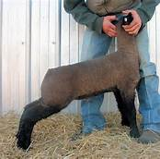
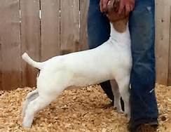
Sheep and Goats 101
Sam Womble
County Extension Agent – Ag/NR
Bandera County

Slide 2
Topics:
Monitoring Condition
Exercising
Fitting
Showmanship

Slide 3
Monitoring Condition
Sheep and goats will put on condition as they mature. Feeding and exercise go hand in hand in terms on managing condition.
Where?
Breast, shoulder pocket, dock, twist
How much is too much?
2-3 tenths
Make adjustments early, don’t wait until the end of the feeding period.

Slide 4
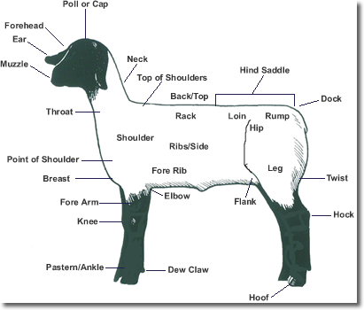

Slide 5
Exercising
Sheep and goats need some condition on them prior to exercising. Exercising burns energy. No condition = muscle loss.
Why?
Fat lambs and goats will not be competitive.
When?
45-60 days from the show

Slide 6
Exercising
How?
Dog, ATV, Horse, Yourself
Treadmill
Track Dimensions
Oval track – 80’ on straight away, 4’ wide; 30’ on corners, 5’ wide; inside fence 4’, outside fence 6’.
Square track – 25 yards each side, 7’ wide
T-post and loosely pulled wire on the inside, corners/sides should be solid.
Use sand or shavings as the track surface.

Slide 7
Exercising
How often?
Depends on the project. Probably 2-3 times a week initially.
How long?
Until they are breathing hard. Start at a distance of 100 yards and work up to 300-400 yards at a time.

Slide 8
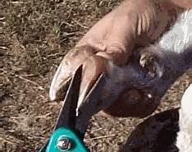
Fitting
Observe and pay attention to projects daily
Keep feet trimmed
Condition skin
Refresh
Show Sheen
Cover with a blanket
Allows the skin to breathe and hydrate

Slide 9
Fitting
Clipping/Shearing
Sheep
1-2 days out of the show
MW – fines or surgicals
FW, FWX, SD – fines
Wavy wool pattern – surgicals
Goats
3-5 days out of the show
Use fines or cover cotes
Shape leg hair/wool for a natural, uniform look.

Slide 10
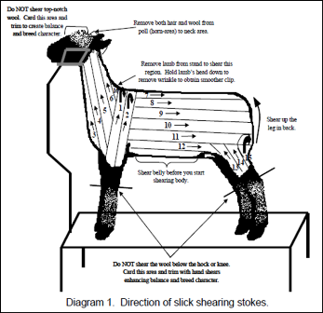
Fitting

Slide 11
Showmanship
Teach your goat to:
Walk, Stop, Drive, Stand still
Lambs and goats that have stamina and have been properly trained will likely outlast their contemporaries.
Practice several times a week.
Utilize siblings, parents or a mirror to assist.

Slide 12
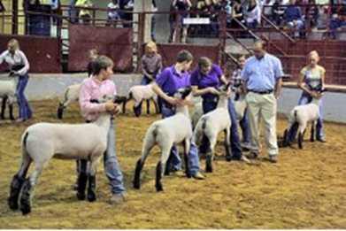
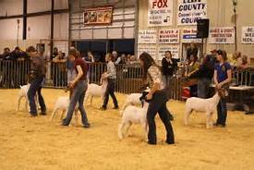
Showmanship
Familiarize yourself with the ring, routine and know who the judge is.
Eye contact

Slide 13
Showmanship
Keep your project set up correctly, but avoid continual driving.
Get lamb or goat ready about three in front of you.
Keep your project between you and the judge.
Be prepared for questions.

Slide 14
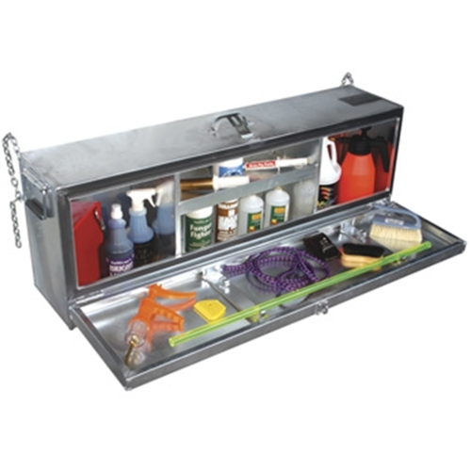
Supply Checklist
Feed/Hay
60 cc Drench gun
Electrolytes
Blanket
Muzzle
Chain/halter
Shampoo, water hose
Towels
Hide Conditioner – Freshen Up, Revive
Brush/wool cord

Slide 15
Closing
Keep a positive attitude.
Learn from your mistakes.
If you will focus on the things you can control and do your best, winning will take care of itself.
Have fun!

